Slide 1



DigiComPass
Conference – Nicosia, Cyprus
27-28 November 2024
Host: University of Cyprus
(SEIT Lab – Computer Science Dept.)
Contact Persons:
Constantinos Tsouris: tsouris.constantinos@ucy.ac.cy
Alexandros Yeratziotis: yeratziotis.alexandros@ucy.ac.cy
Ioanna Theophilou: theophilou.ioanna@ucy.ac.cy

Slide 2
Meeting Information
  Venue:
  University of Cyprus (New Campus).
  Room details are listed on the schedule.
  Address: University Avenue, 2109, Aglantzia, Nicosia (Athalassa area)
  The new university campus is a main stop in the routes of
  multiple bus lines that you can use to move into the rest of the city.
  Easy to arrive by taxi as well.

Slide 3
Accommodation in Nicosia
  Hotels in the city center:
    Castelli Hotel: www.castellihotel.com.cy
    Centrum Hotel: https://centrumhotelcyprus.com/
    Royiatiko Hotel: http://royiatikohotel.com.cy/
    Altius Boutique Hotel: https://altiushotel.com/
    The Sendal Boutique Hotel: https://www.thesendal.com/
    MAP Boutique Hotel: https://www.maphotel.com.cy/
    Madama Residence: https://madama.com.cy/
    Gate Twenty Two Boutique Hotel: https://gate22hotel.com/
    Classic Hotel: www.classic.com.cy
  Hotels outside the city center:
    Cleopatra Hotel: https://cleopatrahotel.com-hotel.com/ (has a pool)
    Semeli Hotel: https://www.semelihotel.com.cy/
    Hilton Nicosia: http://hilton-park-nicosia.nicosia.top-hotels-cy.com/en/ (has a pool)
    Asty hotel: https://www.astyhotel.com/

Slide 4
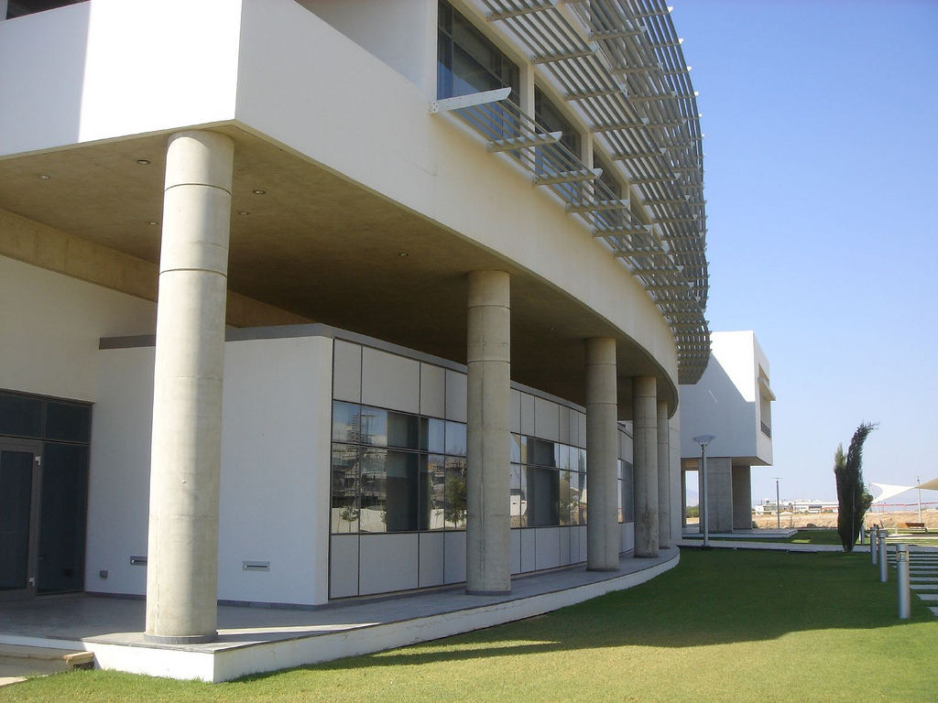
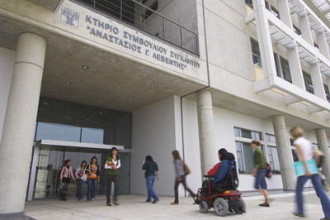
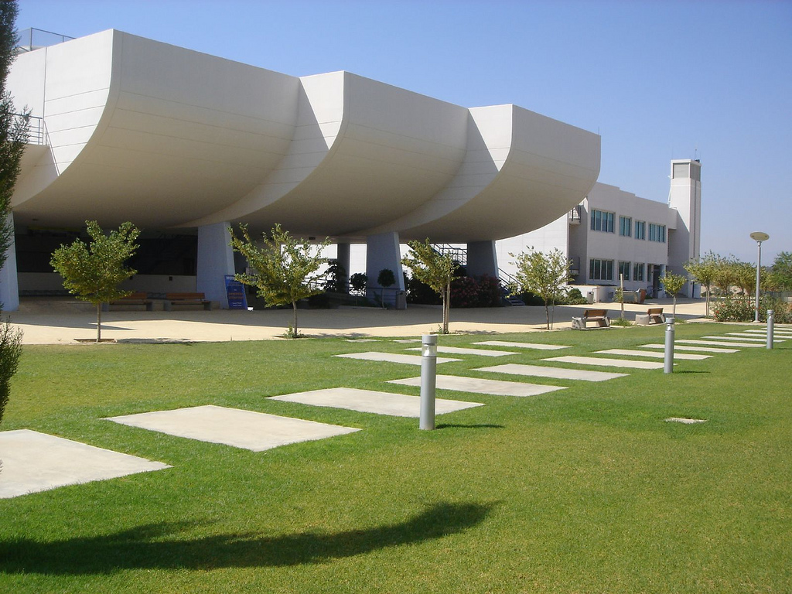
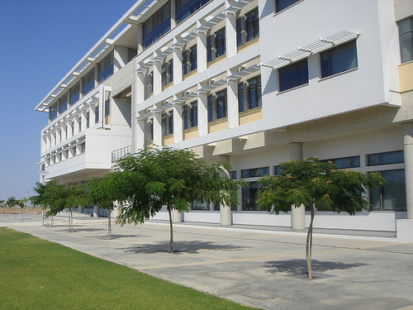
University of Cyprus

Slide 5
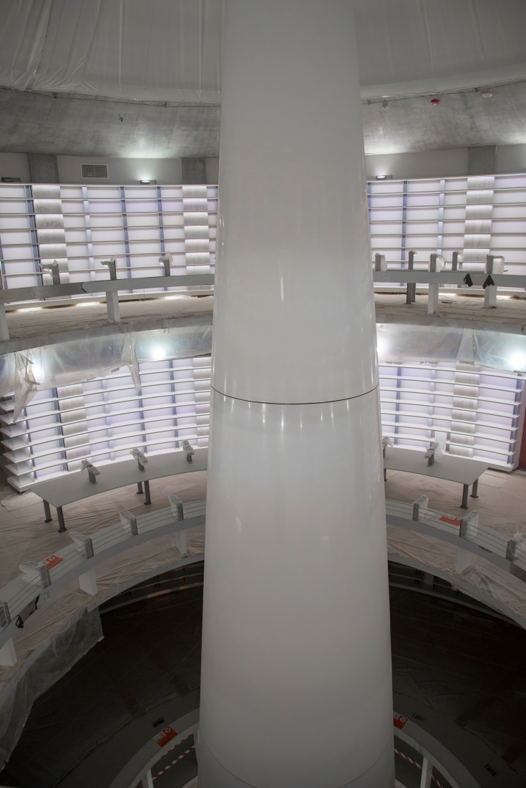
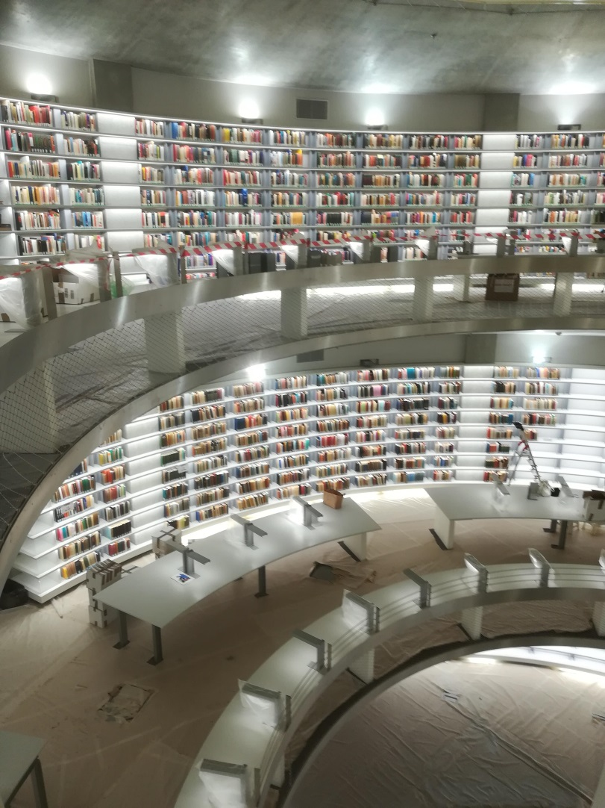
UCY New Library by famous Jean Nouvel

Slide 6
Flying to Cyprus
  AIRPORTS
  Cyprus has two (2) airports:
    The Larnaca International Airport, which is located about 5km (3 miles) from Larnaca town centre.
    The Paphos International Airport, which is located about 15km (9 miles) from Paphos town centre.

Slide 7
Reaching Nicosia
  Larnaca Airport to Nicosia
  The service from Larnaca Airport to Nicosia and reverse is provided by KAPNOS AIRPORTS SHUTTLE. Please visit their webpage for more information: www.kapnosairportshuttle.com.
  A one-way ticket costs €9.00.
  Paphos Airport to Nicosia
    Shuttle: The service from Paphos Airport to Nicosia and reverse is provided by KAPNOS AIRPORTS SHUTTLE. Please visit their webpage for more information: www.kapnosairportshuttle.com.
    A one-way ticket costs €16.00.
    Bus: Firstly, use the public bus route 613 from Paphos Airport to reach Pervola-Karavela Station (www.pafosbuses.com/en). Then from Pervola-Karavela Station take the Public Bus Company "Intercity Buses": www.intercity-buses.com to get to Nicosia (Solomou Square Station, this is in the city center).

Slide 8
Moving Around
  Taxi:
  Proposed Taxi Company: Dias Taxi Services – 22 262999, VIPS TAXI - 22 318318
  Public Transportation:
    A list of all buses around Cyprus including night buses, rural buses and intercity buses can be found on "Cyprus by Bus" website at www.cyprusbybus.com. The buses are separated by city while route details, timetables and maps are available for each route.
Cyprus Public Transport
    Please visit the official website to view Nicosia routes: https://www.publictransport.com.cy/routes/page/routes-and-timetables
  Inner-city Bus Routes
    Please visit the official website to view all routes between cities: https://intercity-buses.com/en/.

Slide 9
General Information
    English is the second language and is widely spoken.
    The currency of the Republic is Euro.
    Banks in Cyprus open for the public from 08:30 to 12:30 midday. Certain banks in tourist areas open during the afternoon.
    The voltage on the island is 240 Socket outlets are of flat 3 pin-type (same as in United Kingdom).
    All types of medication are available in well stocked pharmacies all over Cyprus.
    Telephone : Cyprus automatic telephone dialing system reaches 206 countries. Telecards can be purchased from Post Offices, kiosks and souvenir shops.
    There are two international airports in Cyprus, at Larnaca and Pafos.
    The two main ports are in Lemesos and Larnaca.
    As from May 2004 Cyprus is a full member of the European Community.

Slide 10
General Information
  Medical facilities
    The health facilities in Cyprus are of a high standard. The latest technologies and operating techniques are standard practice, with heart bypass surgery and kidney transplantation operations routine in the island’s hospitals. The accident and emergency departments of all the hospitals are manned with English-speaking personnel, but it's advisable to seek the assistance of an interpreter for more complex medical matters. Emergency treatment in the Accident and Emergency department, is free to tourists.

Slide 11
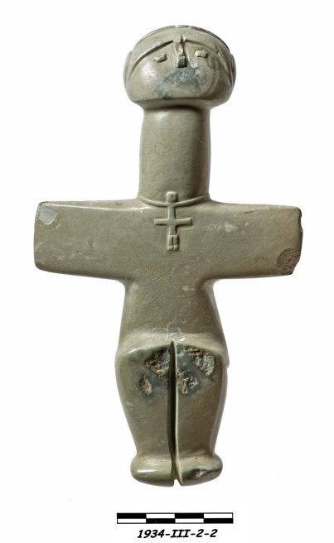
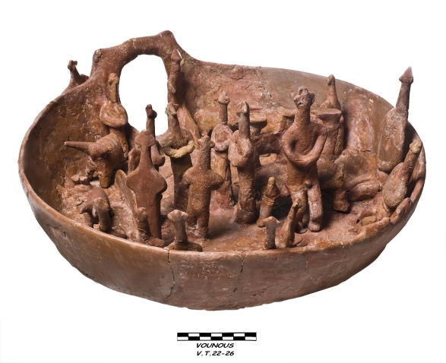
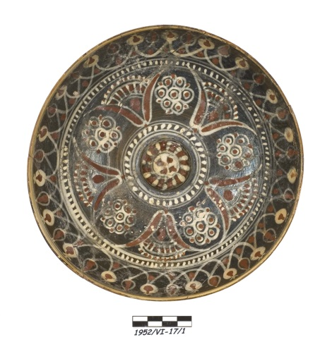
Museums
  Cyprus Museum

Slide 12
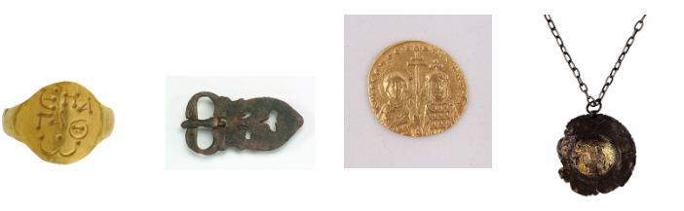
Museums
  Leventis Municipal Museum
    Permanent Galleries
      Ancient Times
      Byzantine Period
      Frankish Period
      Venetian Period
      Ottoman Period
      British Rule
      Nicosia 1960 until today

Slide 13
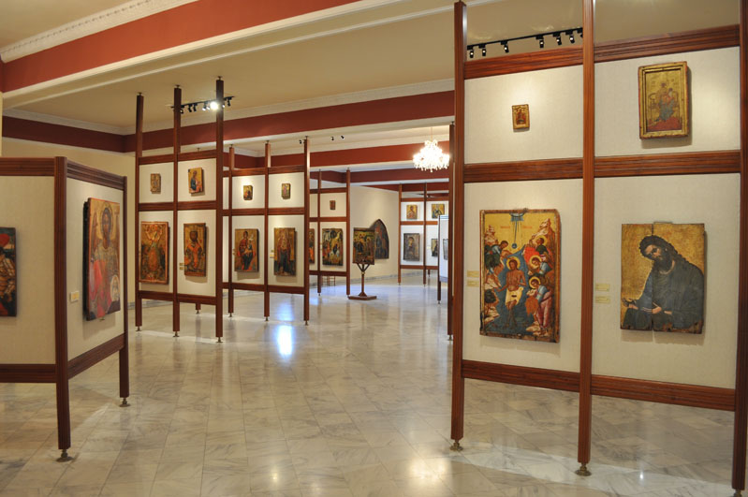
Museums
  Archibishop Makarios III Foundation – Cultural Center (Byzantine Period)

Slide 14
Art Galleries
  Art Galleries
    NiMAC: Nicosia Municipal Arts Centre.
    Leventis Gallery.
    State Gallery of Contemporary Art.

Slide 15
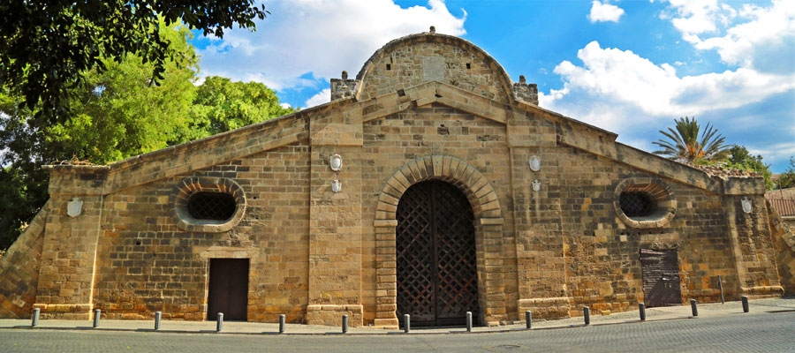
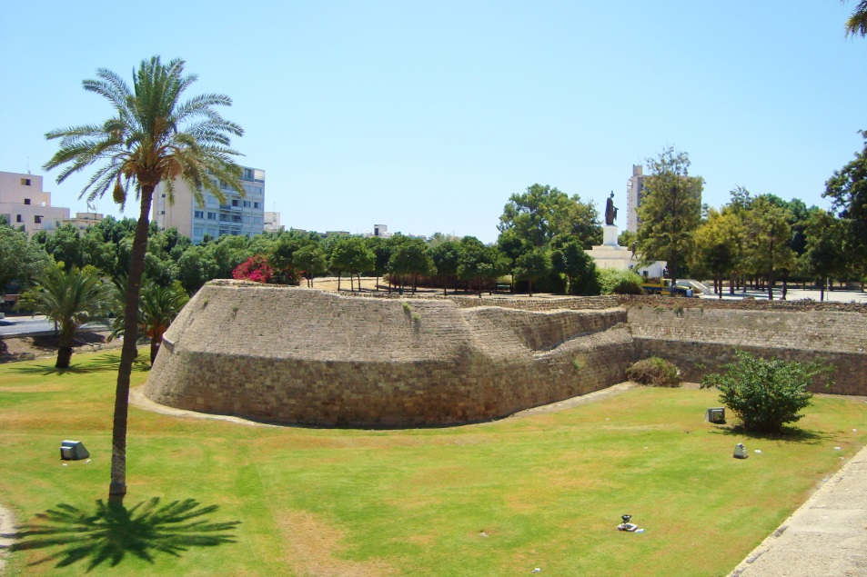
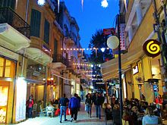
  Nicosia Old City Center

Slide 16
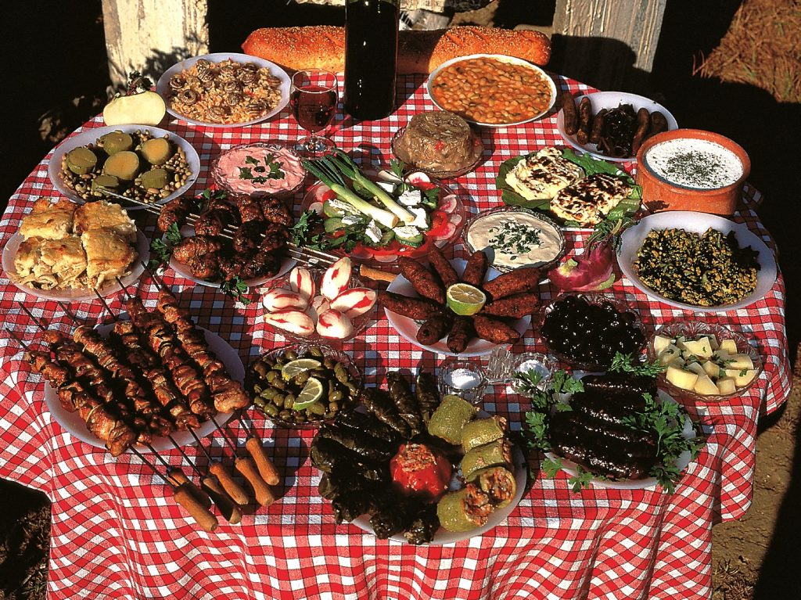
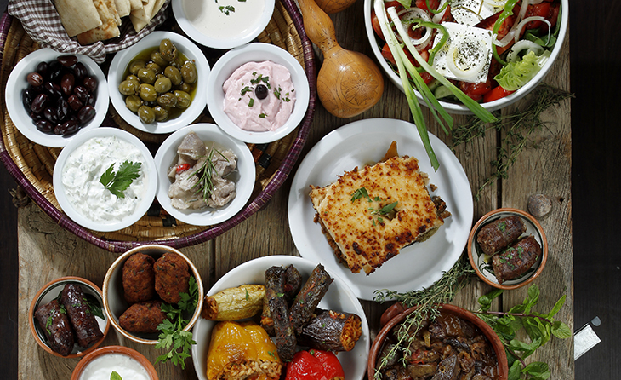

Slide 17
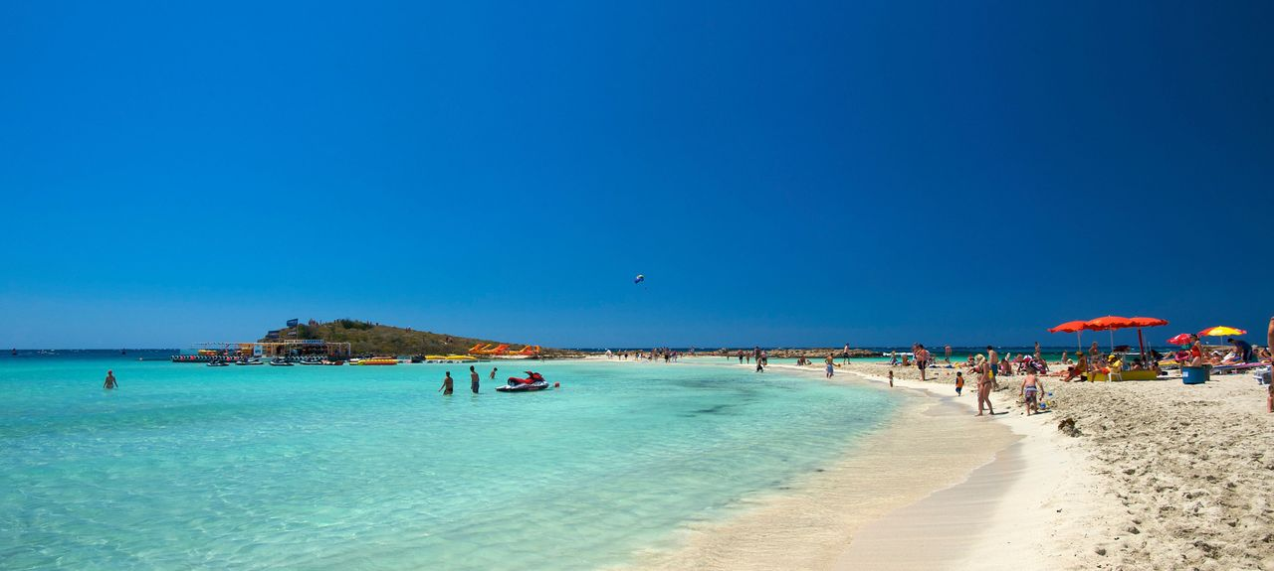
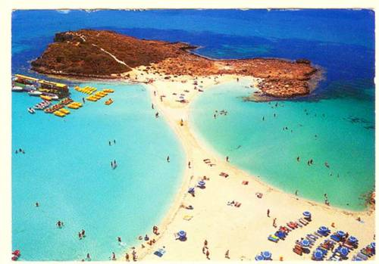
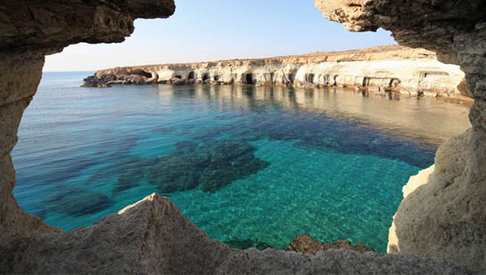

Slide 18
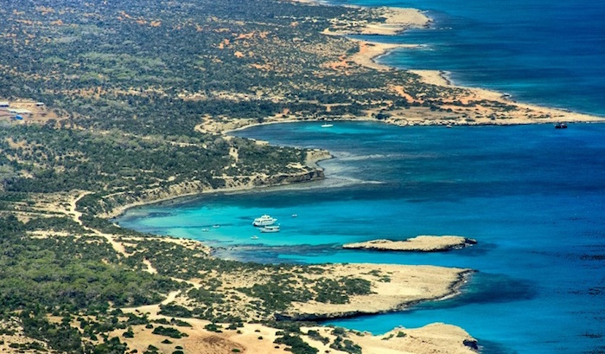
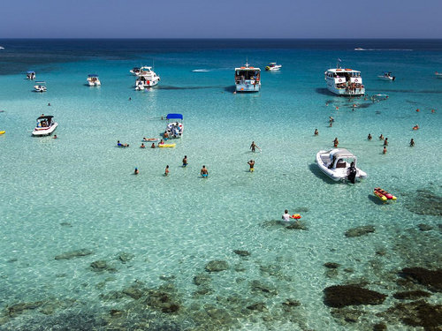
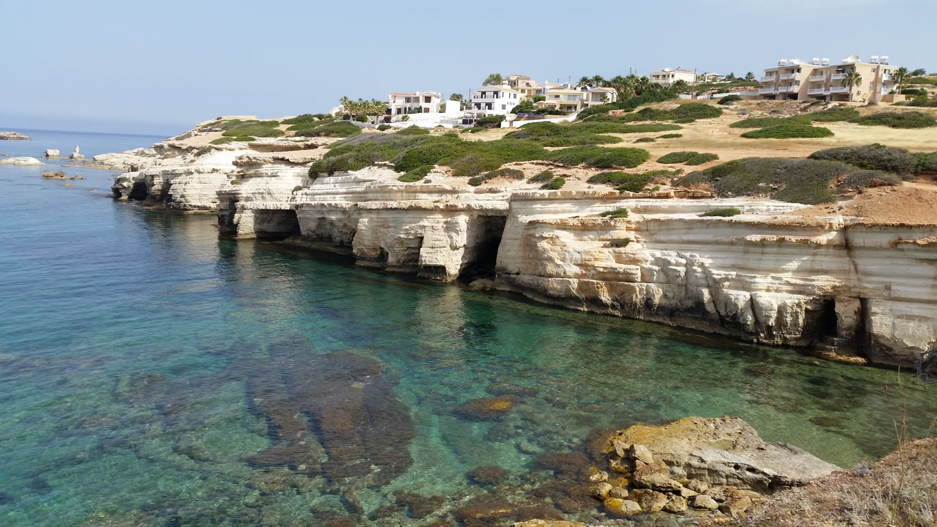

Slide 19
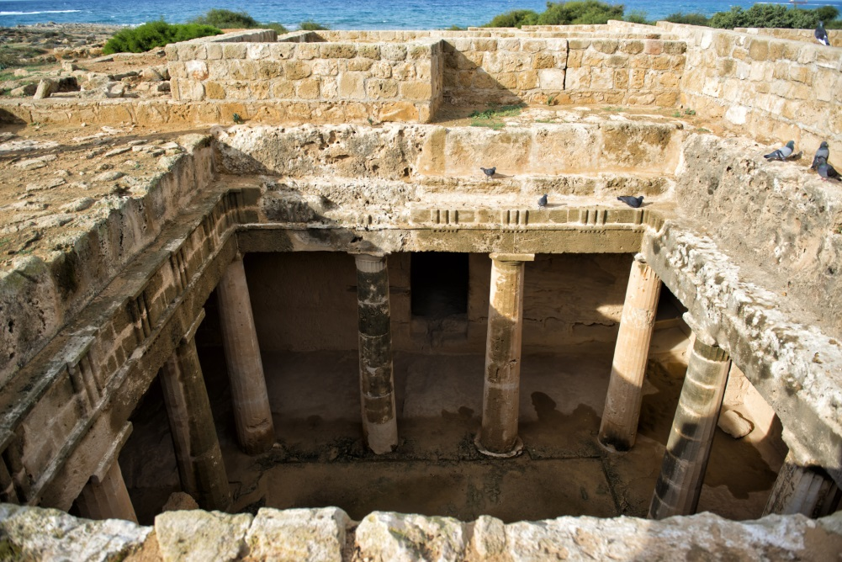
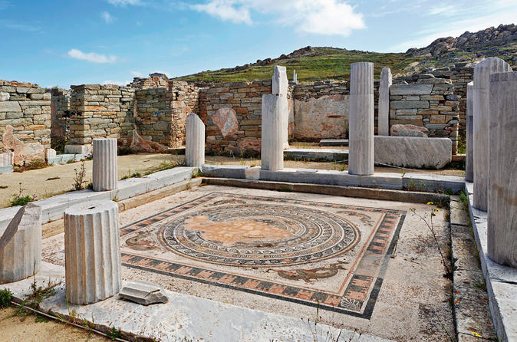
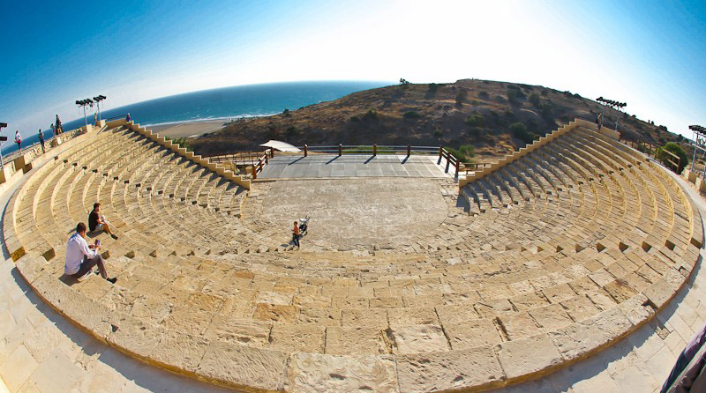
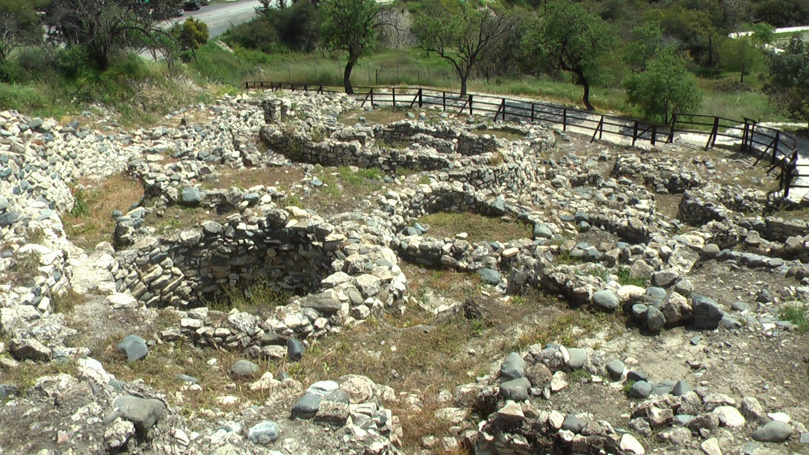

Slide 20

Thank you!
www.ucy.ac.cy/seit

